Slide 1
Pet Market
Student ID | 20105211
Student Name | Syed Hassan Raza Naqvi
Course Code | CMP7163
Course Name | Advance Mobile Computing

Slide 2



Introduction
The aim is to design a pet market application for Android users.
User will be able to find information about Pet foods, toys, medicines, and other essential pet products available on the nearest company stores (based on user location).
Main purpose of the application is to make customer’s life easy by delivering all sort of information in advance, so user can make informed decision regarding which store to visit for buying required pet product.

Slide 3
Features
Location Services: Application will show search results based on user location
Web Services: User will be able to search and access data related to pet products.
Additional Features
Core Features
Social Media: App will allow users share information on social media accounts (i.e. Facebook, Twitter, and Instagram).
Local Database: User can bookmark any data and save that information on the application locally for future referencing.

Slide 4
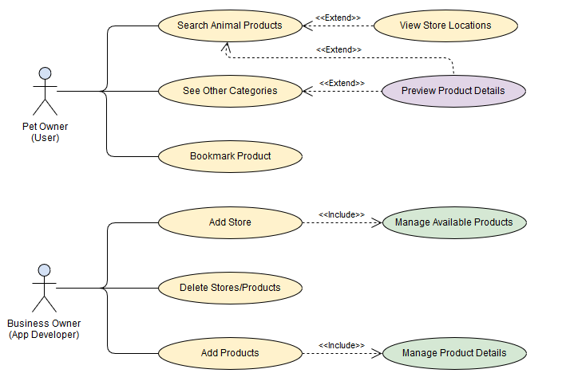
Use case diagram

Slide 5
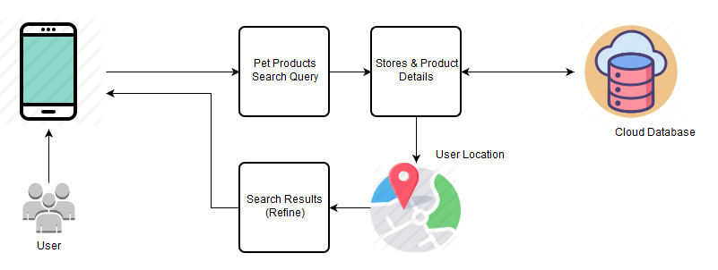
Architecture diagram

Slide 6
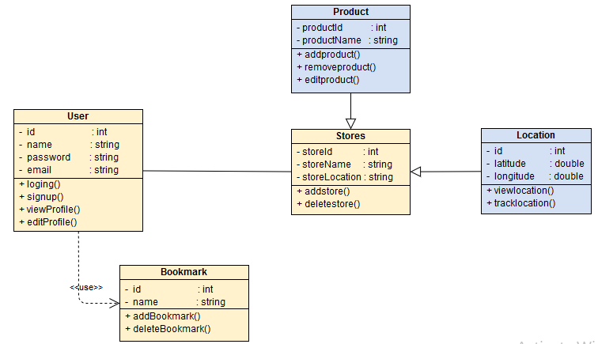
class diagram

Slide 7
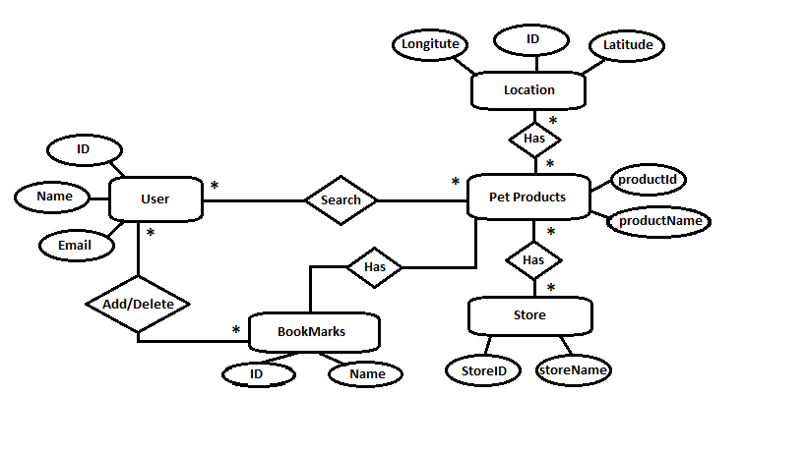
Entity relation diagram

Slide 8
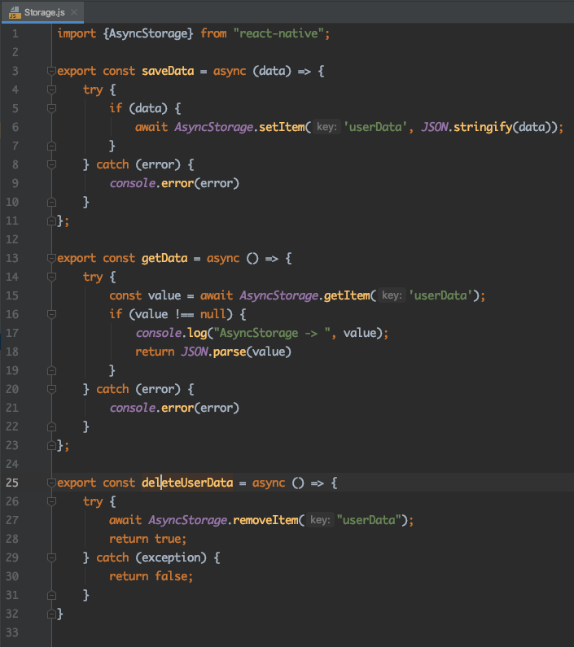
Code snippet
Data Persistence
Saving User Data to Async Storage

Slide 9
Code snippet
Data Persistence
Retrieving User Data from Async Storage

Slide 10
Code snippet
Data Persistence
Deleting User Data from Async Storage

Slide 11
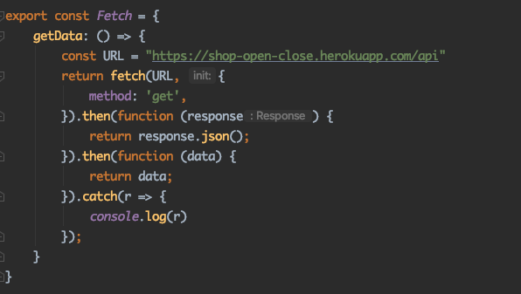
Code snippet
Getting Data From API using Fetch instructions

Slide 12
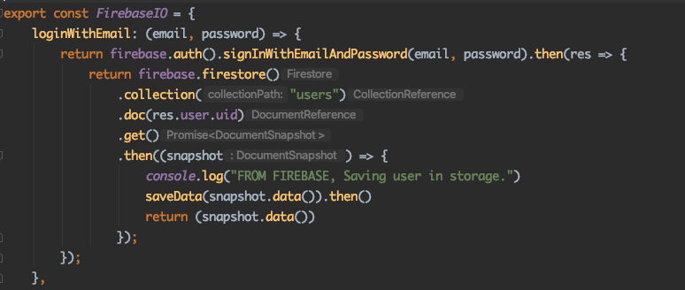
Code snippet
Logging into Firebase
Log in Using Email and Password

Slide 13
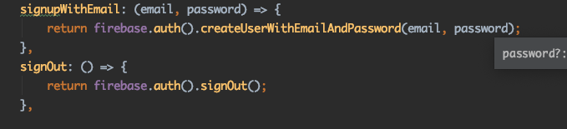
Code snippet
Sign Up with Email Function
Sign Out Function

Slide 14
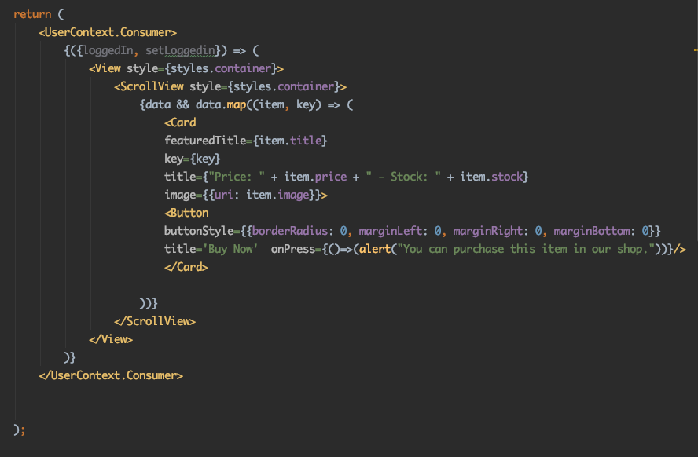
Code snippet
This code snippet displays a product in a card view

Slide 15
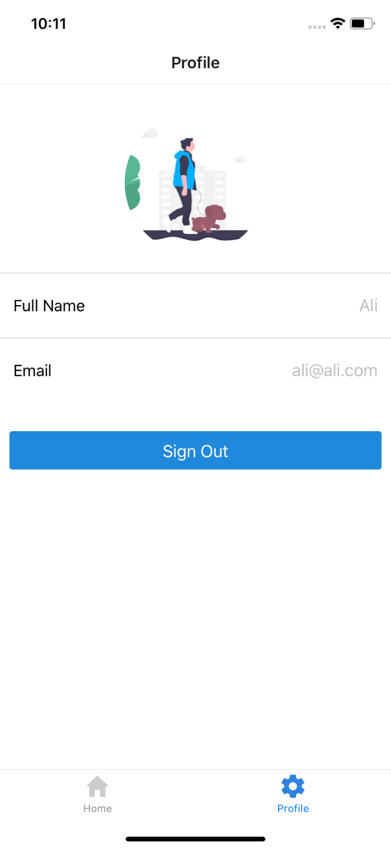
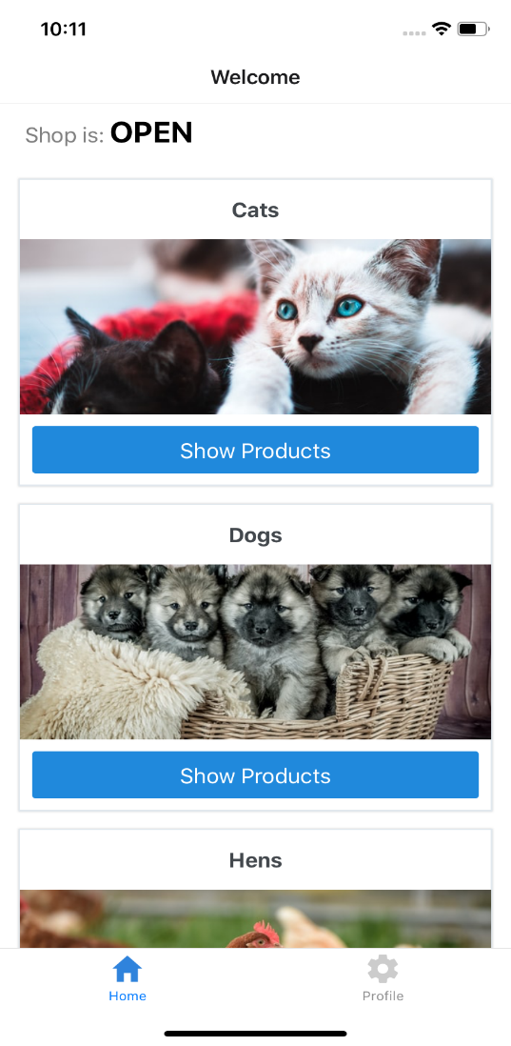
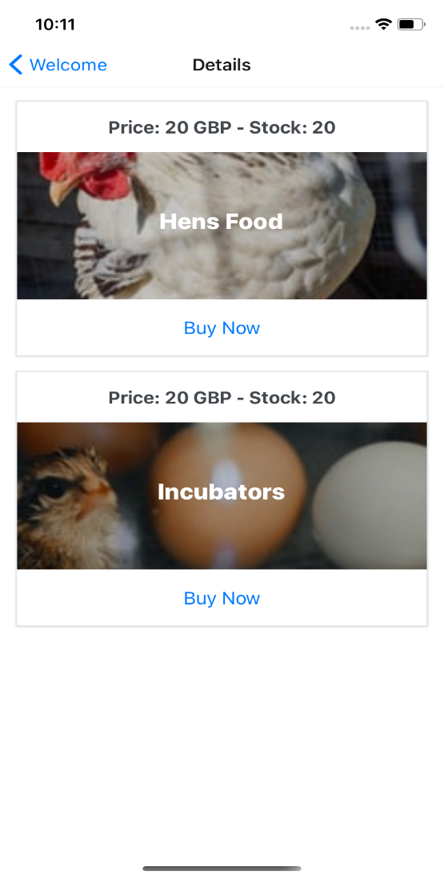
App screenshots

Slide 16
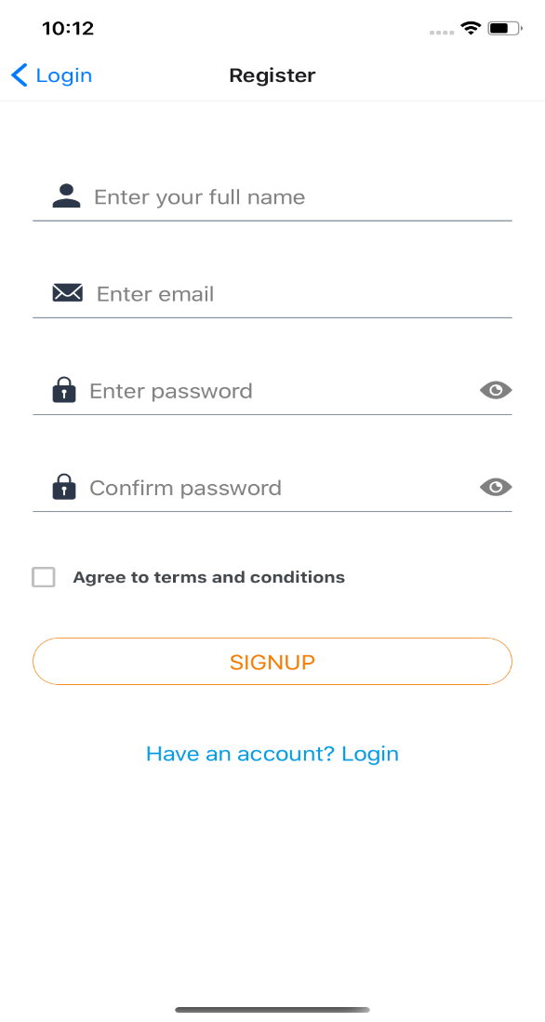
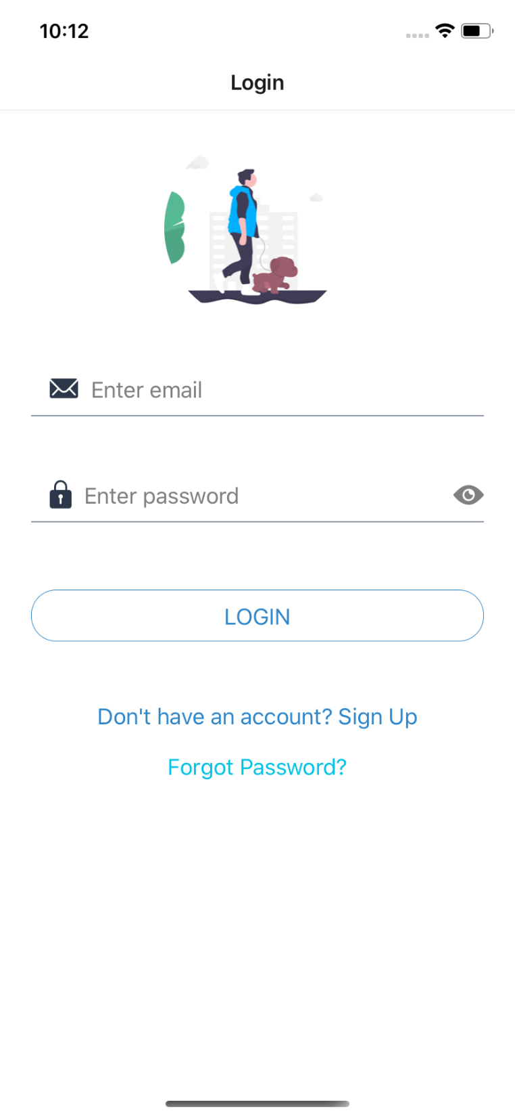
App screenshots

Slide 17

App video

